Slide 1


Akshaya Patra for London Microsoft Hackathon
Team Patato

Slide 2
Content
Aims
Key Challenges
Solution Strategy
Details
Conclusion

Slide 3

Aims
Measuring the impact of the program in terms of child health
Measuring satisfaction (quantity/quality) of food served
Analysing feedback and health metrics, and incorporating this data into menu/ingredient supply decisions

Slide 4

Key Challenges
Lack of technology in schools, makes large scale online polling difficult (low-tech)
How data is collected - students may feel under pressure into giving better feedback if directly asked my their teacher/worrying that criticism will be seen as disrespectful
Speed - ideally, results from polls should be gathered in real-time and directly incorporated into the decision making process

Slide 5


Solution
Equipping Akshaya Patra member with a basic tablet and a web application
1) for collecting the feedback from children
2) for collecting basic health data
Asking only 5% of the students population

Slide 6
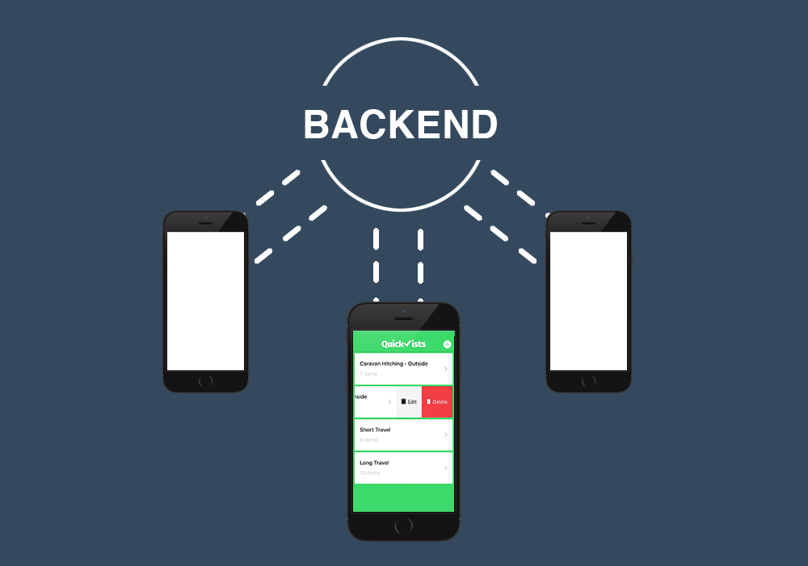






Measuring satisfaction (quantity/quality) of food served
Input of the data
Data is sent to the server in real time
Scripts are used to analyse data and determine the future decisions
The output is clearly presented via graphs

Slide 7

Step 1 ) Front-End Interface
Web-UI for regions with Internet access
Native tablet app for less well-connected areas to store data locally and send it as soon as Internet is available
Possible voice synthesiser for younger kids
Button for reading out the question (in case a child cannot read)

Slide 8
Step 1 & 2 - Input and communication with Backend
Questions to be asked to the student:
Is your tummy full ?
Did you eat mid-meal served in you school ?
Do you have any illness or discomfort after eating the food ?
Does Akshaya Patra food taste like the food served in your home ?
Is the food always hot when it is served ?
Which menu items do you like the most ?
More questions can be added as needed
Answers are sent to the backend centralized database
when an internet connection is available

Slide 9
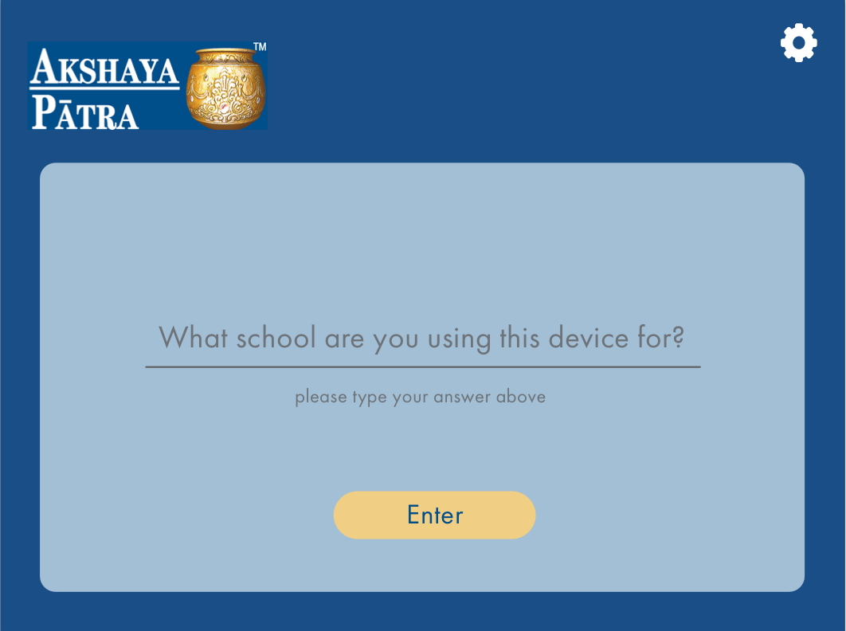
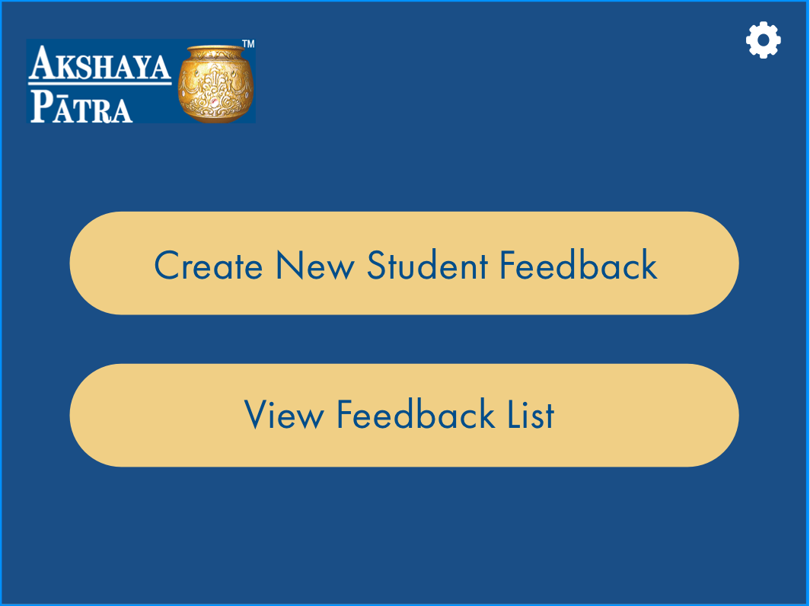
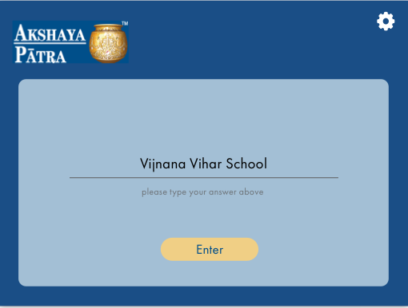

Slide 10


Slide 11


Slide 12
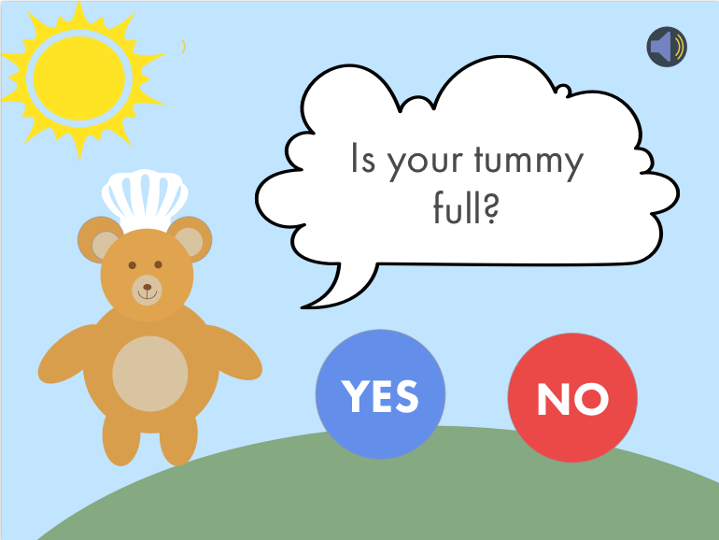

Slide 13
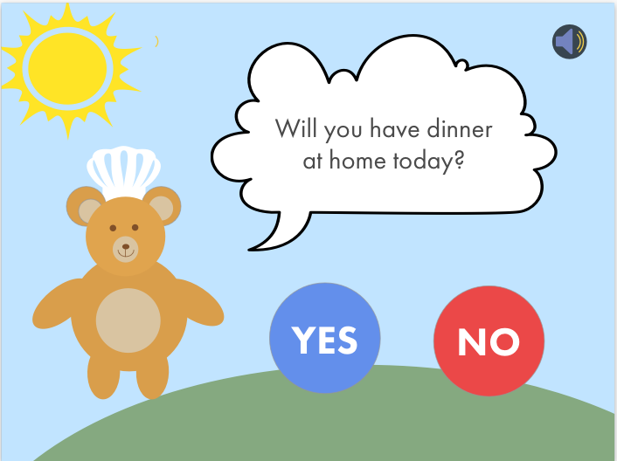

Slide 14
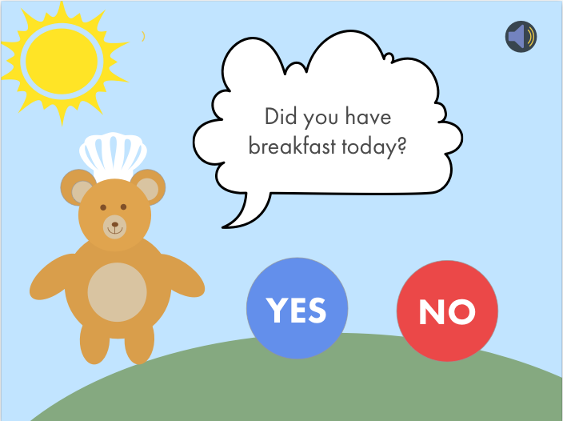

Slide 15


Slide 16


Slide 17
Step 3 - Analysis
Python based analysis using NumPy
Key matrix:
Total number of kids that eat only our meal
% of kids who enjoyed the meal
Number of kids who were still hungry
Any more statistics that may be needed

Slide 18

Step 4 - Output
The output visualized will be in a graph format
The processed data will provide actionable insight in measures that can be taken to improve child health and satisfaction

Slide 19



2) Measuring HEALTH impact (survey taken by member of the organisation)
Health inputs via camera or question-based
(4 times a year)
Data is sent to the backend system
Storing child health data
View trends in child health to assess meal programme impact

Slide 20





Health Questions
Ask about their tiredness
Low iron levels
Heart disease
Thyroid problem
Ask about illness history
Malnutrition can cause lowered immune response
Take BMI
Take weight and height
Take pictures of nails:
Lack of iron, protein, vitamins
Take pictures of teeth
Lack of vitamin C

Slide 21

Tracking
Track the same students (around 5% of the school population) over a period of 1 year, taking assessments every 2 months
Randomly sampling students to form this 5% will provide insight into common deficiencies in the school/region
Measurements over time, allow quantification of the impact that the Akshaya Patra meal programme provides

Slide 22


Slide 23
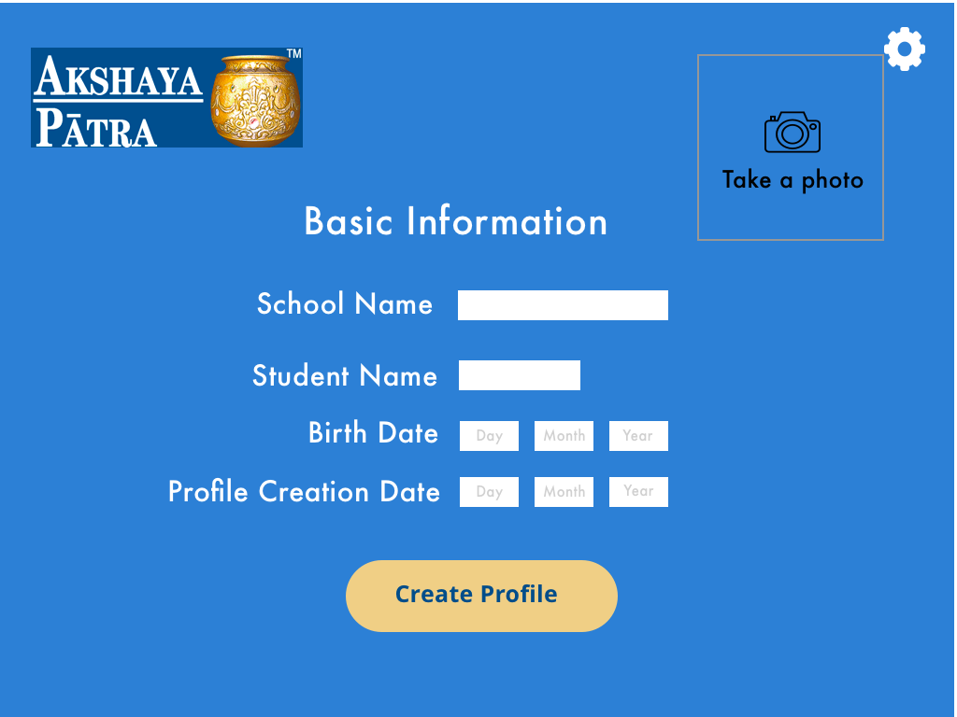

Slide 24


Slide 25
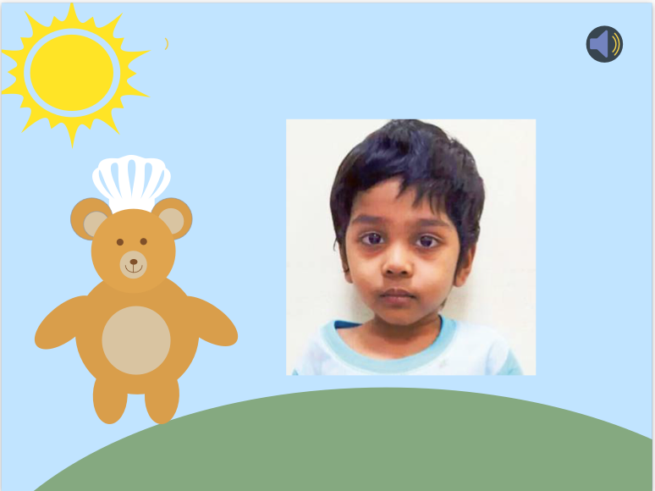

Slide 26
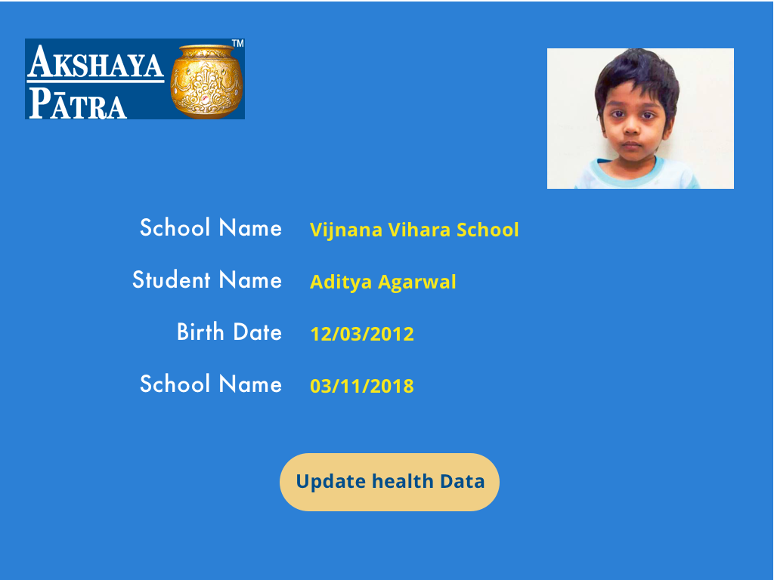

Slide 27
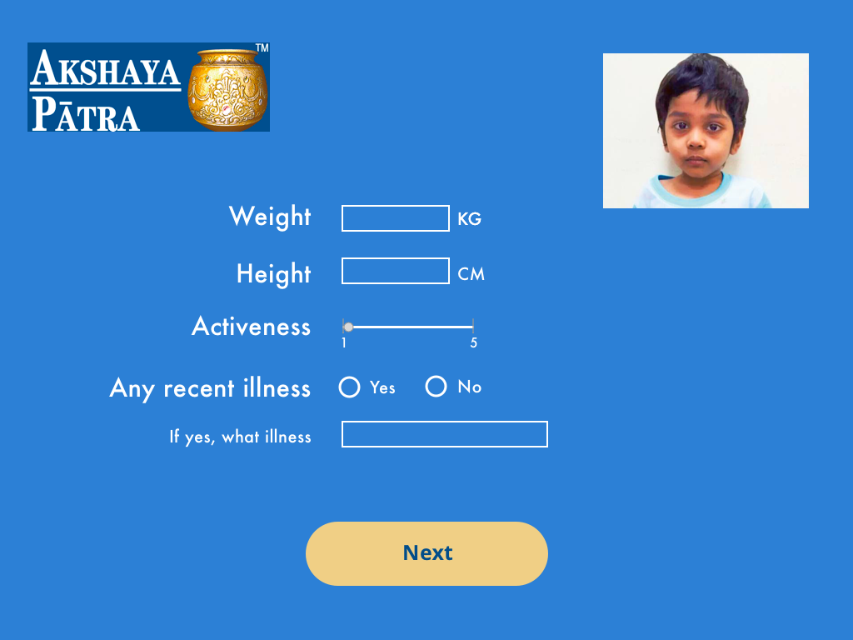

Slide 28
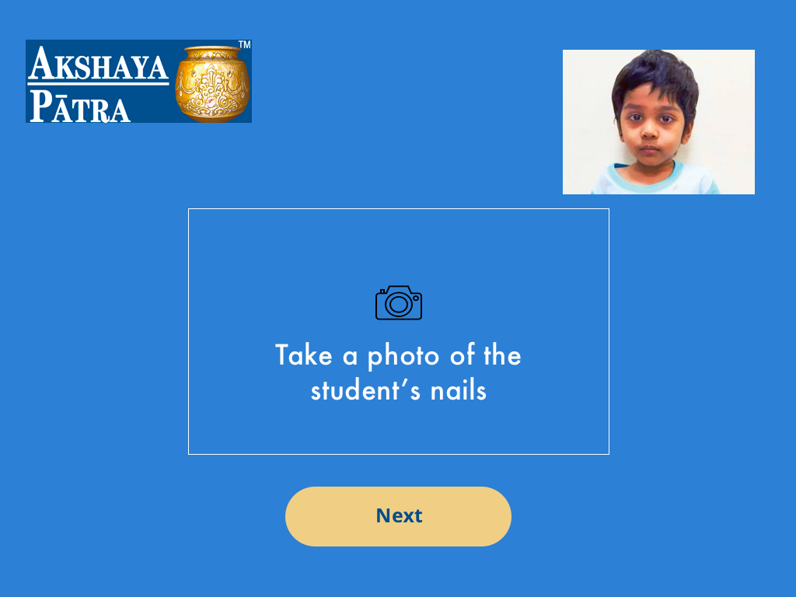

Slide 29


Slide 30
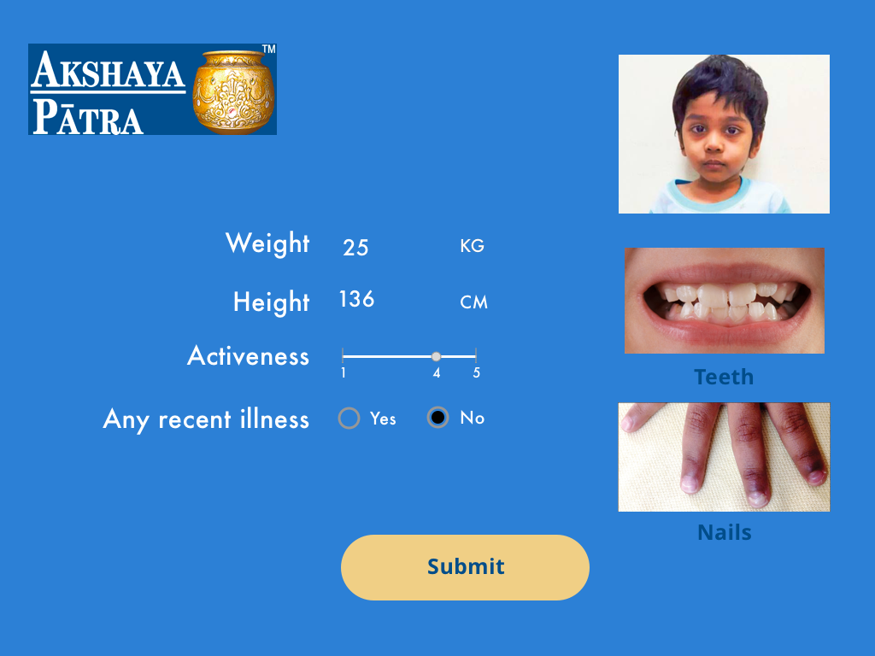

Slide 31


Slide 32
Thank you. Questions?

